Slide 1
Major project “AzureChat Bookscape
Submitted By – Submitted To –
Name – Vishwajeet Singh Supervisor – Mr.Tabrej Ahmad
Enrollment No – 2020-310-238

Slide 2
ABSTRACT
In an era dominated by digital connectivity and online services, the secure deployment of public-facing applications and problem solving of customers stands as an essential cornerstone for businesses and organizations seeking to deliver seamless experiences while safeguarding sensitive data and user privacy. In this context, the deployment of a Microsoft Azure secure infrastructure and Azure AI services assumes paramount importance, necessitating a meticulous approach that combines cutting-edge technology, robust architecture, and stringent security measures. This project embarks on a comprehensive exploration and implementation of strategies aimed at fortifying a public-facing application hosted on Microsoft Azure. It delves into the intricate layers of security, scalability, and accessibility required to create a resilient infrastructure capable of withstanding the evolving threat landscape while ensuring uninterrupted service delivery to a broad user base. Through a strategic amalgamation of industry best practices, Azure's suite of security services, and a proactive stance toward mitigating potential risks, this project endeavors to outline a blueprint that not only prioritizes security but also addresses the intricate balance between user accessibility and system robustness and this project also highlights the AI services provided by Microsoft Azure. By examining key elements such as identity and access management, network security, encryption mechanisms, and incident response strategies, this report aims to provide a comprehensive guide for designing, implementing, and maintaining a secure Azure infrastructure tailored explicitly for public-facing applications, thereby instilling trust, reliability, and resilience in the digital ecosystem.

Slide 3
OBJECTIVE
The primary objectives of this report are to explain the concept, design, implementation, and use of the project titled “AzureChat Bookscape. This endeavor involves a thorough assessment of existing security risks and vulnerabilities inherent in deploying applications to the public domain. The report aims to outline a comprehensive Azure infrastructure blueprint that not only prioritizes security but also emphasizes scalability and accessibility for the intended application users and also tells about the Azure AI services like chatbot. To achieve this, industry-leading best practices and an array of Azure security services & Azure AI services will be strategically employed to shield against common threats including DDoS attacks, potential data breaches, and unauthorized access attempts. Robust identity and access management (IAM) policies will be developed and implemented to precisely govern user access to Azure resources and the application itself. Furthermore, the deployment plan will integrate a multi-layered security architecture, encompassing network security, encryption mechanisms, and vigilant monitoring tools to ensure the safeguarding of data both in transit and at rest. The selection and utilization of pertinent Azure services such as Azure App services, Azure AI services & Azure language studio will be instrumental in augmenting the protective measures of the infrastructure and use of AI services. Rigorous testing, inclusive of penetration testing and vulnerability assessments, will be conducted to identify and rectify any security gaps that may compromise the integrity of the Azure infrastructure. The formulation of robust incident response and recovery plans is imperative to swiftly mitigate the impact of potential security breaches or incidents that may affect the public-facing application hosted on Azure. Comprehensive documentation and guidelines for ongoing security maintenance, updates, and compliance adherence within the Azure environment will be provided. Continuous monitoring, evaluation, and the iterative enhancement of security measures will ensure the perpetuity of a robust and resilient secure infrastructure for the public-facing application.

Slide 4
SYSTEM MODEL
The components in the Application are –
Pay as you go subscription: Azure's Pay-As-You-Go subscription lets you use services without long-term commitments. You're billed based on actual usage, with no upfront costs. It's flexible, scalable, and offers global availability. You can monitor spending and optimize costs using Azure's tools.
Resource group: A resource group in Azure is a logical container that holds related resources. It helps organize and manage resources, applies policies and permissions, facilitates deployment and deletion as a unit, tracks billing and usage, and supports resource locks to prevent accidental changes.
Azure AI services: Azure AI services offer pre-built AI models and tools to add intelligent features to applications. They include Cognitive Services for vision, language, and decision-making, Azure Machine Learning for building and deploying ML models, Azure Bot Service for building bots, Azure Databricks for analytics, Azure Cognitive Search for powerful search capabilities, Azure Speech Services for speech-to-text and text-to-speech, and Azure Video Indexer for extracting insights from videos.
Azure App services: Azure App Service is a platform for quickly building, deploying, and scaling web applications and APIs. It supports various languages and frameworks, offers automatic scaling, integrates with CI/CD tools, provides managed infrastructure with built-in security, supports containers, integrates with Azure services, and enables global scalability

Slide 5
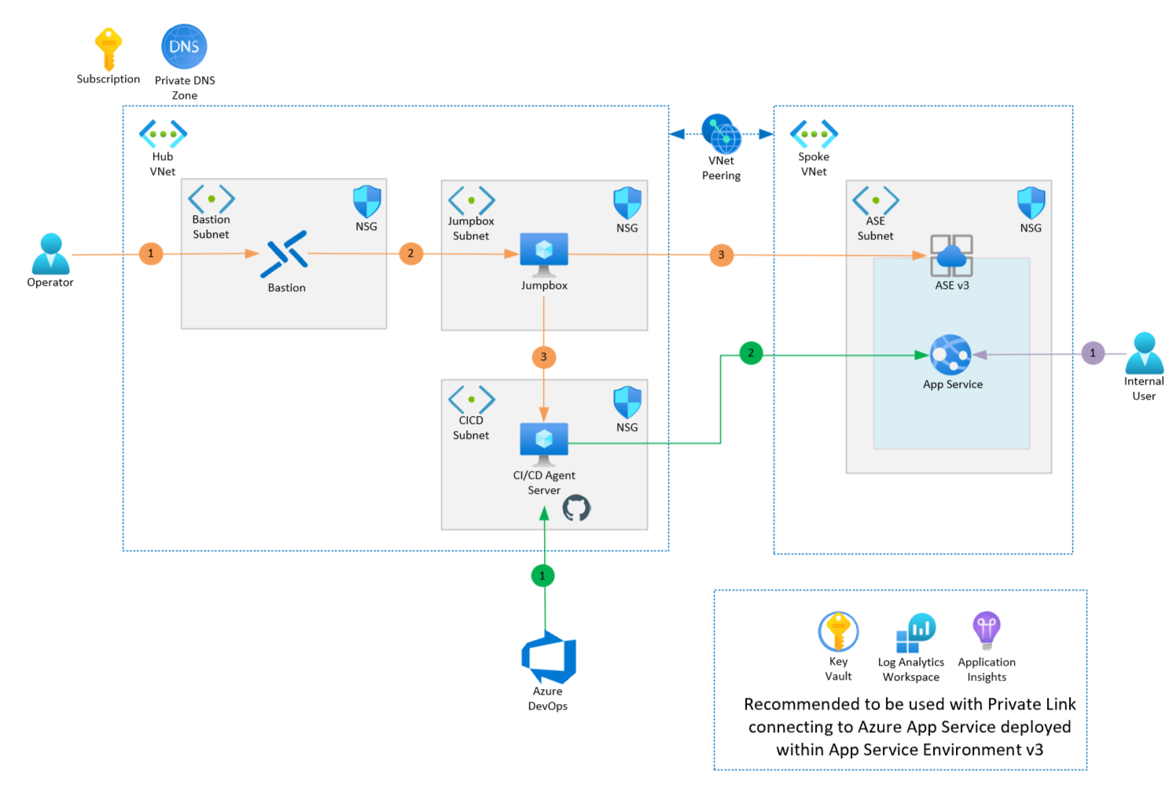
BLOCK DIAGRAM

Slide 6
IMPLEMENTATION AND TESTING
The Application is hosted through Microsoft Azure as a part of secure deployment and Azure AI services.
Azure App service and azure storage account is created for hosting and Language service is used creating a Chatbot.
The App service and storage is used for providing secure infrastructure for application and chatbot is used for user’s problem solving.
After the creation of chatbot, it is deployed on the application code and then tested with questions to see whether it is working perfectly or not.
After the deployment the application is tested with URL provided by the Azure and using the URL we can see how the application is working after deployment on Azure.

Slide 7
Limitataions
The limitations of an Azure-based public placing platform could vary based on the specific implementation and configuration, but here are some potential limitations one might encounter:
1. Scalability Limits: While Azure offers excellent scalability options, there may be limitations depending on the specific services used, pricing plans, and configurations. Scaling beyond certain thresholds may incur additional costs or require architectural changes.
2. Latency: Depending on the geographical location of Azure data centers and the distribution of users, there might be latency issues, especially for users accessing the bookstore from regions far from Azure data centers.
3. Dependency on Azure Services: Relying heavily on Azure services could pose a risk if there are any service outages or disruptions. While Azure is generally reliable, occasional downtime can still occur.
4. Data Sovereignty and Compliance: Azure operates data centers globally, which could raise concerns regarding data sovereignty and compliance with regulations such as GDPR, particularly if the platform serves customers in regions with strict data protection laws.
5. Vendor Lock-In: Building the platform using Azure services might lead to vendor lock-in, making it challenging to migrate to other cloud providers in the future if needed.
6. Cost: While Azure provides a pay-as-you-go pricing model, costs can still accumulate, especially if resources are not optimized or usage spikes unexpectedly. It's important to monitor usage and optimize resource allocation to avoid unexpected expenses.
7. Technical Complexity: Azure offers a wide range of services and features, which can be overwhelming for inexperienced users. Setting up and managing an Azure-based online bookstore may require significant technical expertise.

Slide 8
Future Scope
The future scope for the deployment of Azure secure infrastructure and AI services is vast, with opportunities for innovation and advancement across various industries. Here are some potential areas where this combination could be leveraged:
1. Cybersecurity: Enhancing Azure's secure infrastructure with AI-powered threat detection and response capabilities can strengthen defense mechanisms against cyber threats. AI algorithms can analyze vast amounts of data to detect anomalies, identify potential security breaches, and automatically respond in real-time to mitigate risks.
2. Compliance and Governance: Implementing AI-driven compliance and governance solutions on Azure can help organizations ensure regulatory compliance, streamline audit processes, and enforce security policies effectively. AI can assist in automating compliance assessments, identifying compliance gaps, and providing actionable insights for risk management.
3. Data Privacy and Protection: Utilizing Azure's secure infrastructure and AI services for data privacy and protection can enable organizations to safeguard sensitive data, detect unauthorized access or usage, and ensure compliance with data protection regulations such as GDPR. AI-driven encryption, anonymization, and access control mechanisms can enhance data privacy and minimize the risk of data breaches.
4. Predictive Maintenance: Deploying AI-powered predictive maintenance solutions on Azure infrastructure can help organizations optimize asset performance, reduce downtime, and extend equipment lifespan. By analyzing telemetry data from IoT devices, AI algorithms can predict equipment failures proactively, schedule maintenance activities efficiently, and optimize resource allocation.
5. Customer Experience Enhancement: Leveraging AI services on Azure, such as natural language processing (NLP) and computer vision, can enhance customer experiences across various touchpoints. AI-driven chatbots and virtual assistants can provide personalized assistance, answer customer inquiries, and facilitate self-service interactions, while computer vision technologies can enable visual search, product recommendation, and augmented reality experiences.

Slide 9

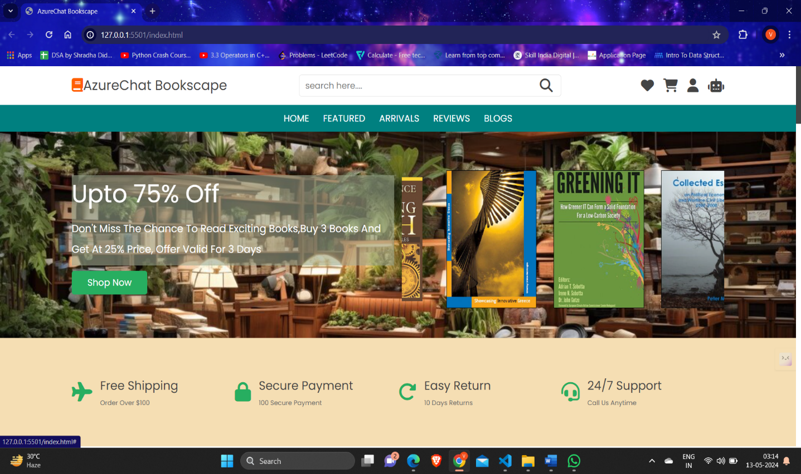
SCREENSHOTS

Slide 10
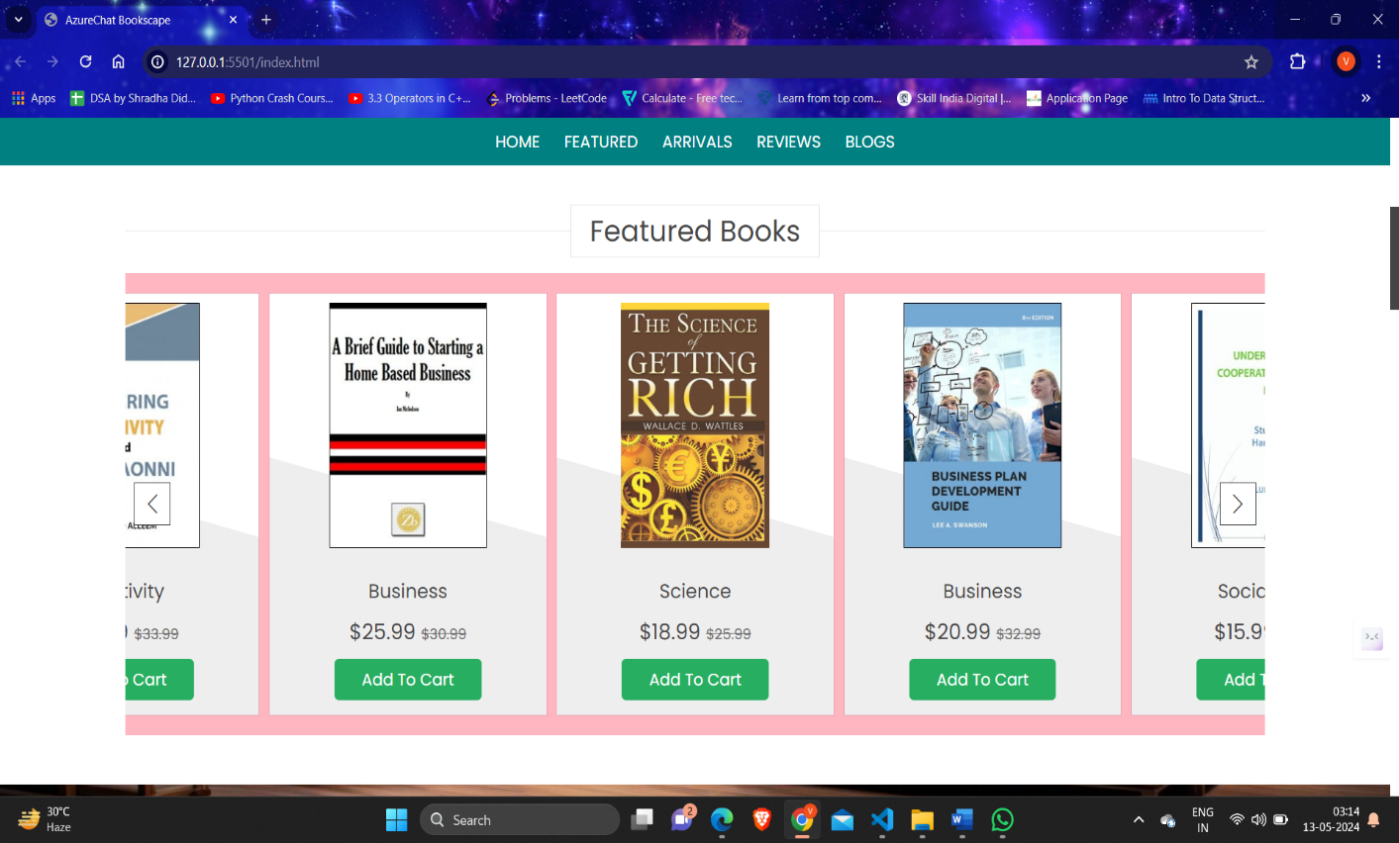
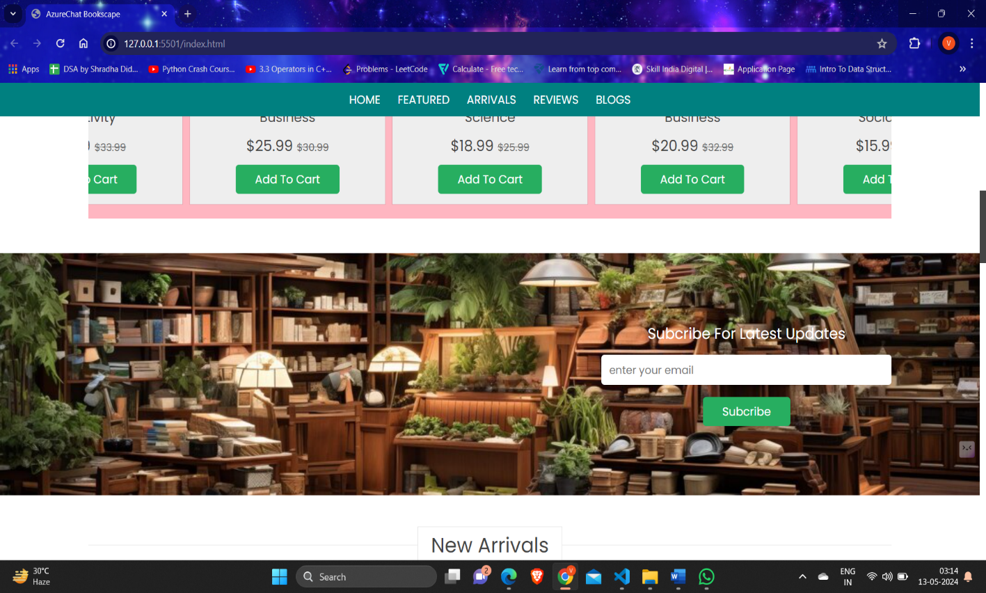
SCREENSHOT

Slide 11
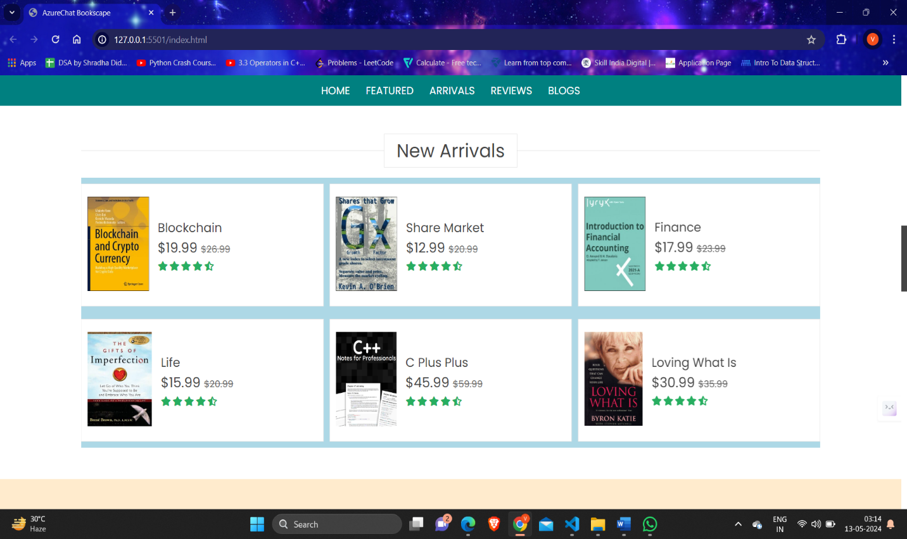
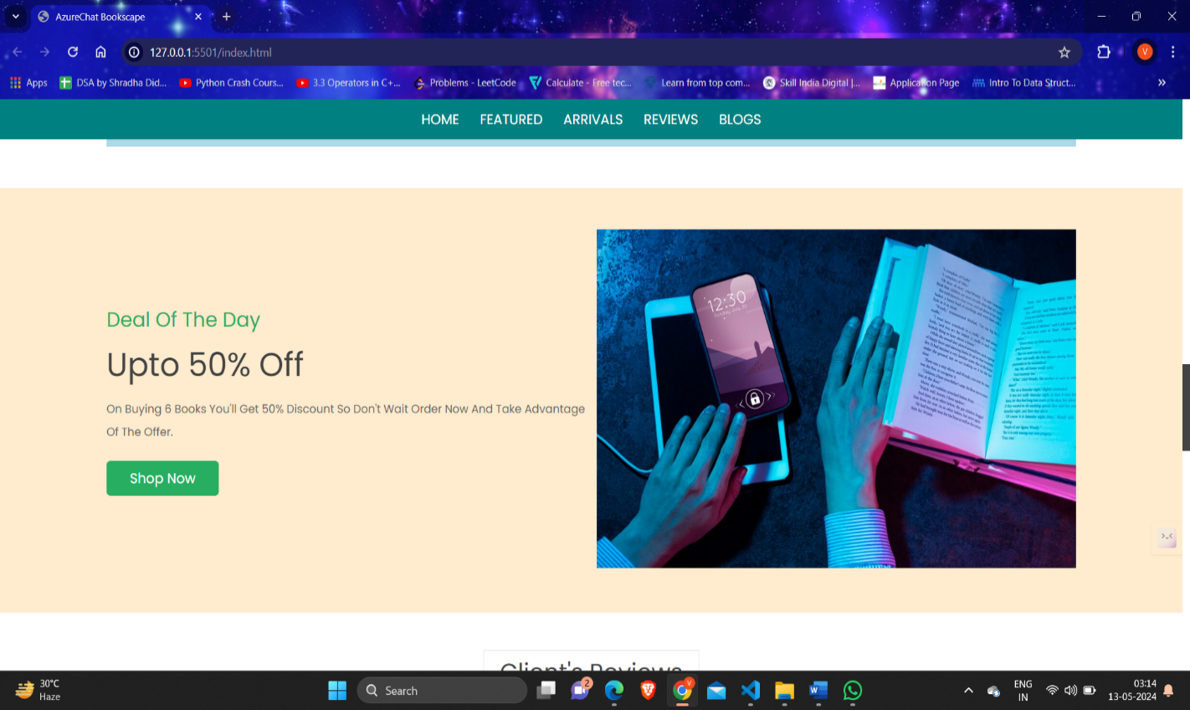

Slide 12
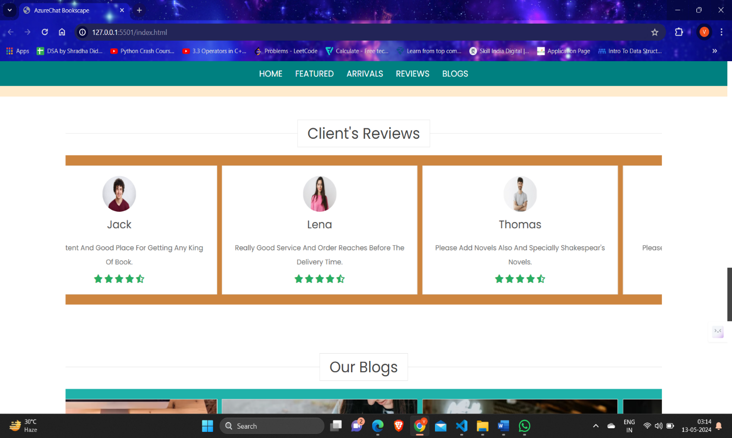
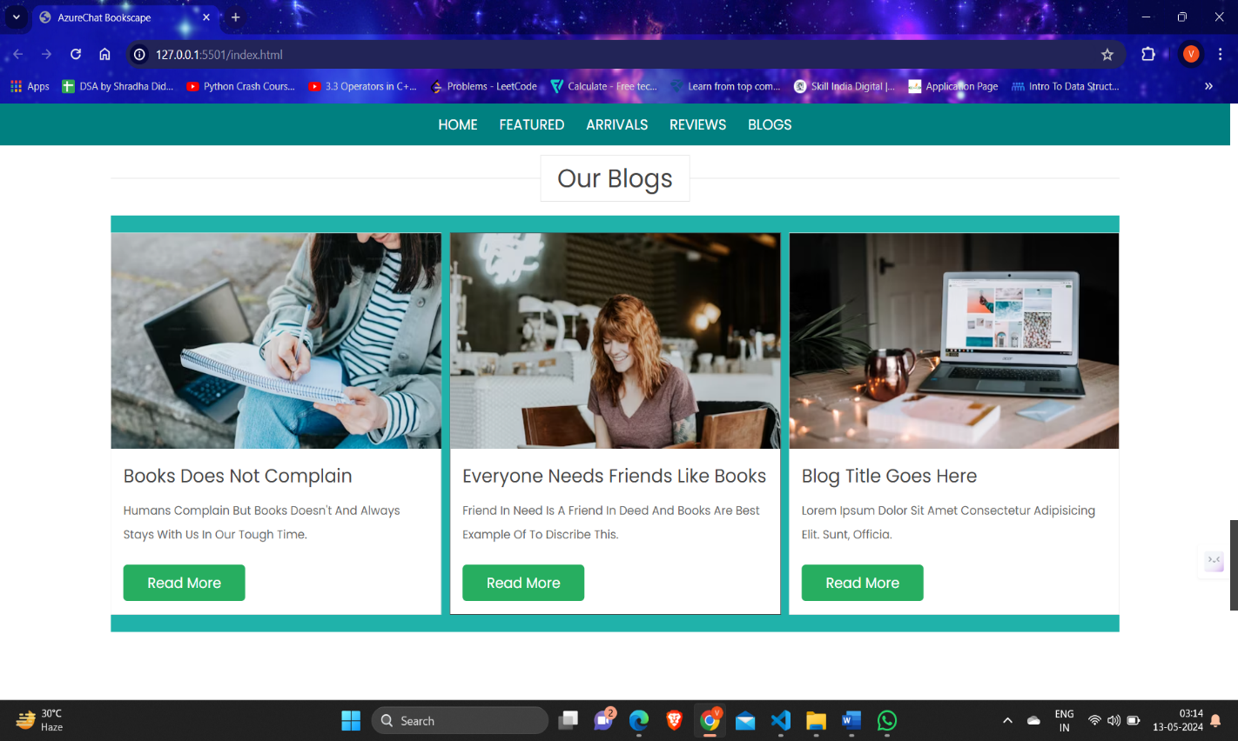

Slide 13
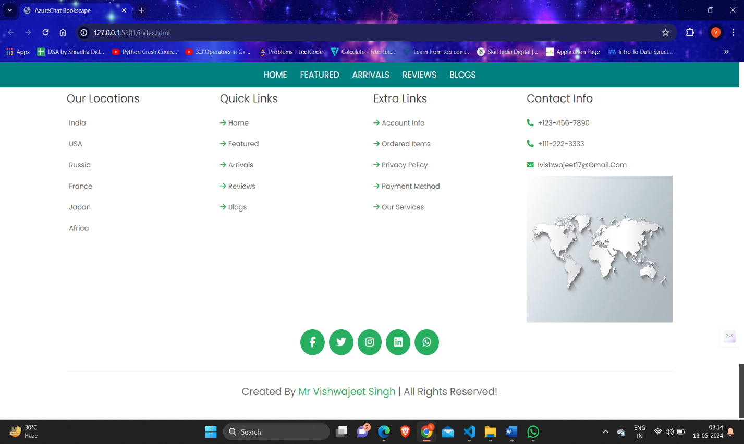
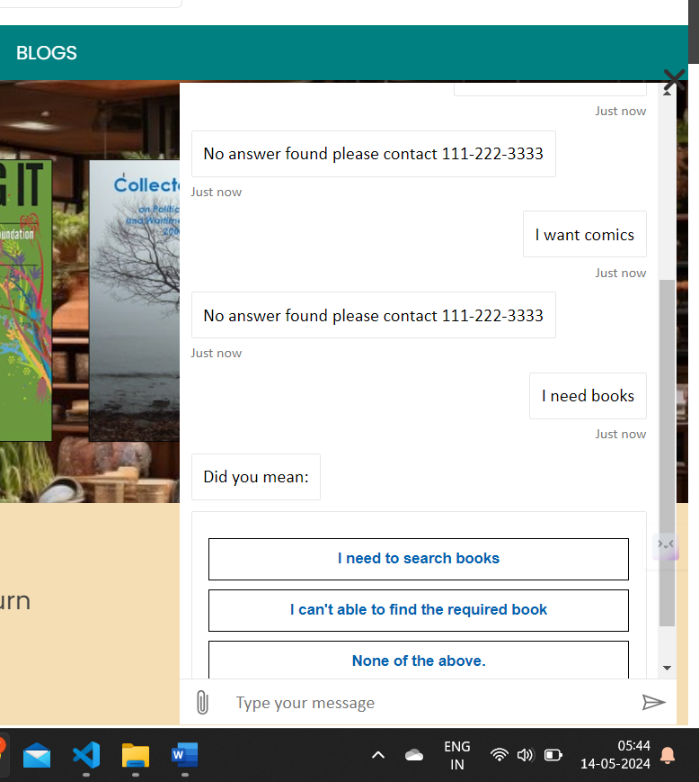

Slide 14
CONCLUSION
Deploying a secure infrastructure and using AI services for a public-facing application on Microsoft Azure is a multi-faceted endeavor crucial in today's digitally interconnected landscape. Throughout this comprehensive journey, the focus has been on fortifying the Azure environment against an evolving spectrum of threats while ensuring the accessibility, scalability, and reliability essential for public-facing applications. The culmination of this deployment emphasizes the criticality of a multi-layered security approach. By meticulously implementing robust identity and access management (IAM) policies, fortified network security measures, encryption protocols, and proactive monitoring tools, the infrastructure stands as a bulwark against unauthorized access, data breaches, and potential service disruptions.Furthermore, the integration of Azure's suite of security services—ranging from Azure DDoS protection and Azure firewall for DDoS protection to Azure Key Vault (AKV) for encryption—has fortified the architecture, fostering a resilient and dependable platform for hosting public-facing applications.The development and adherence to incident response plans underscore the agility required to swiftly mitigate and recover from potential security breaches, bolstering confidence in the system's ability to maintain operational integrity.In conclusion, the deployment of a secure Azure infrastructure and Ai services for public-facing applications signifies a commitment to not only safeguarding sensitive data and user trust but also fostering an environment conducive to seamless, high-performance, and uninterrupted experiences. The continuous pursuit of best practices, compliance adherence, and vigilance in embracing emerging security trends shall perpetuate the resilience and adaptability of this secure infrastructure in the ever-evolving digital landscape

Slide 15
REFERENCES
YouTube
Microsoft Azure
Google

